Slide 1


Pham Ninh Phuong Thao
Home
Service
About Us
Contact
Website
Wordpress.org
01

Slide 2
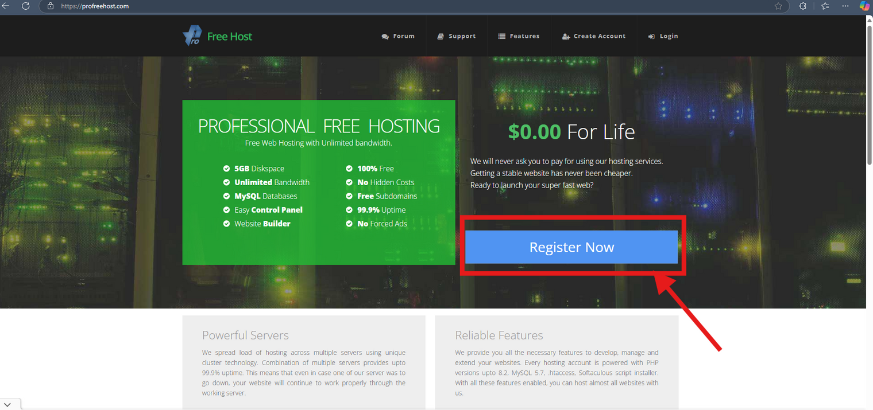
Wordpress.org
Hosting
02

Slide 3
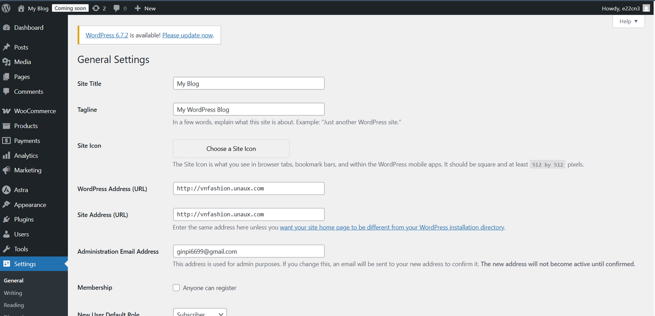
Wordpress.org
Change
Tagline & Site Title
02

Slide 4
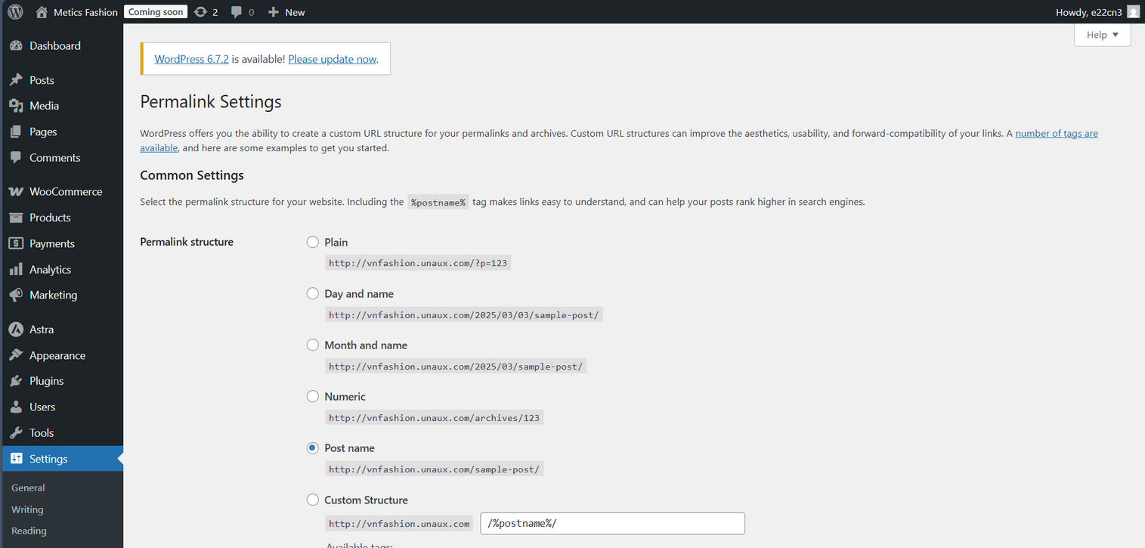
Wordpress.org
Permalink structure
02

Slide 5
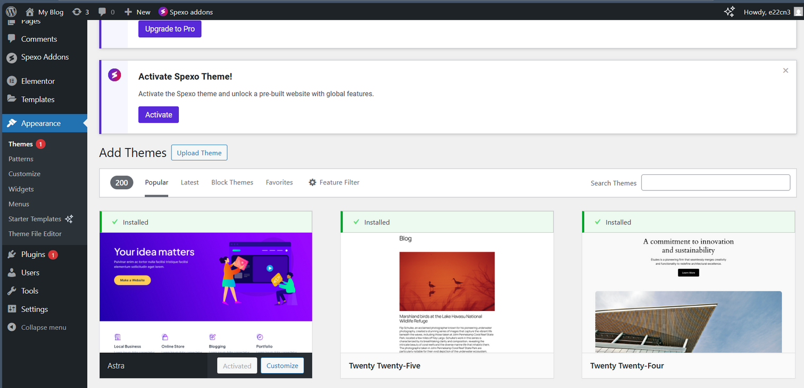
Wordpress.org
Theme Installing
02

Slide 6
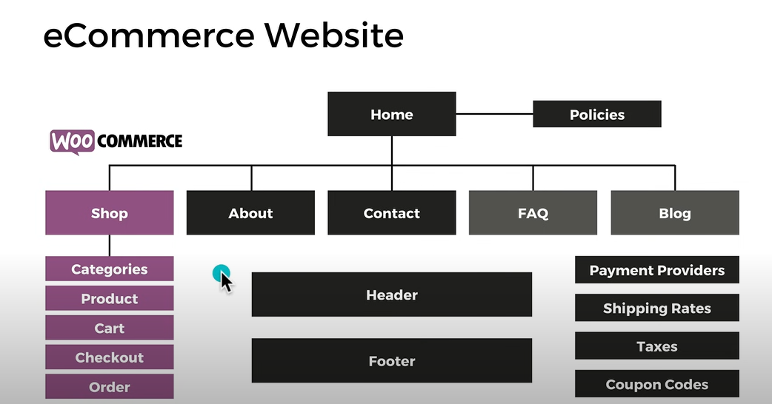
eCommerce Website Structure
01
03

Slide 7
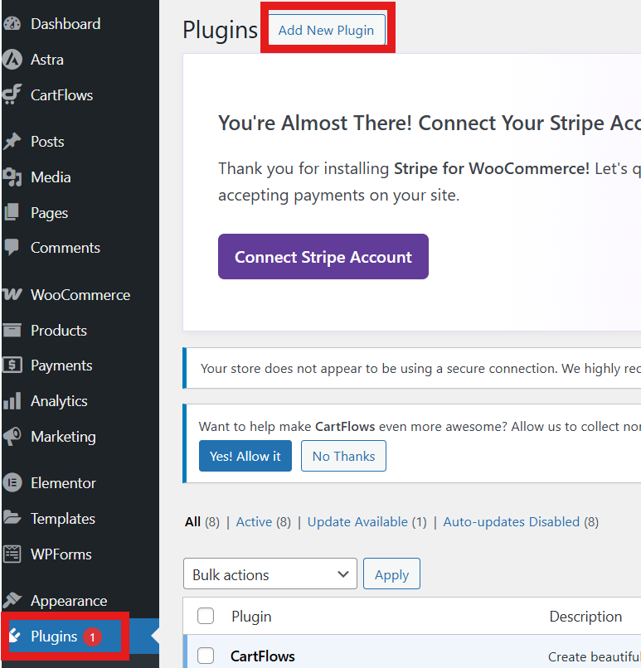
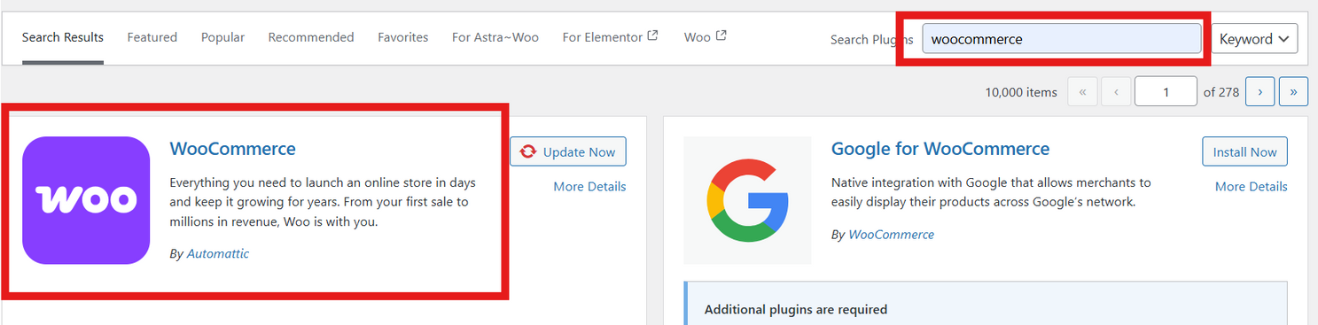
WooCommerce Installing
01
03

Slide 8
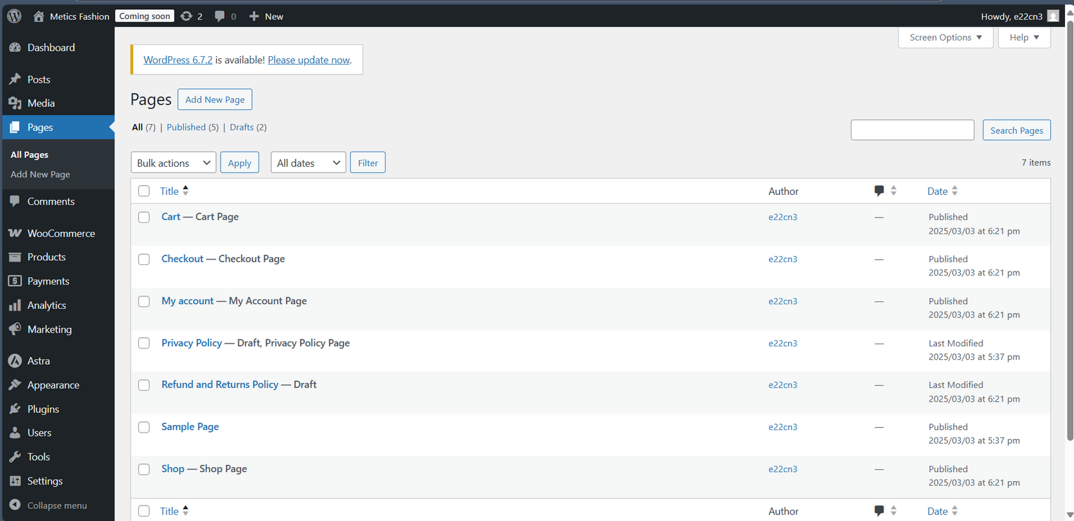
Studio Shodwe
Home
Service
About Us
Contact
Create Pages
02
04

Slide 9
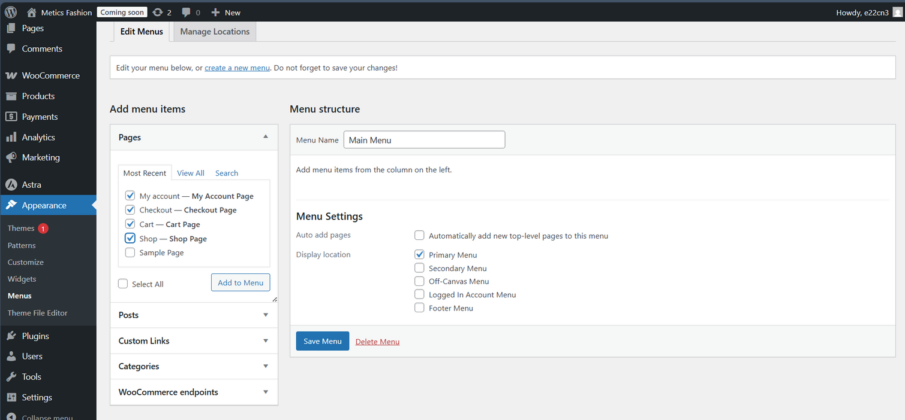
Studio Shodwe
Home
Service
About Us
Contact
Create Menu
04

Slide 10

Studio Shodwe
Home
Service
About Us
Contact
Homepage
Design
04

Slide 11

Studio Shodwe
Home
Service
About Us
Contact
Text Edit
04

Slide 12
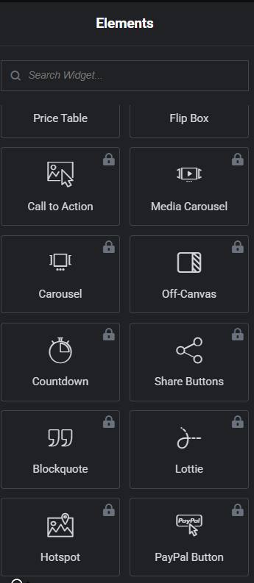
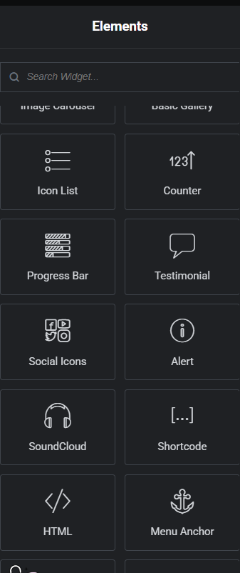
Studio Shodwe
Home
Service
About Us
Contact
Elements
04

Slide 13
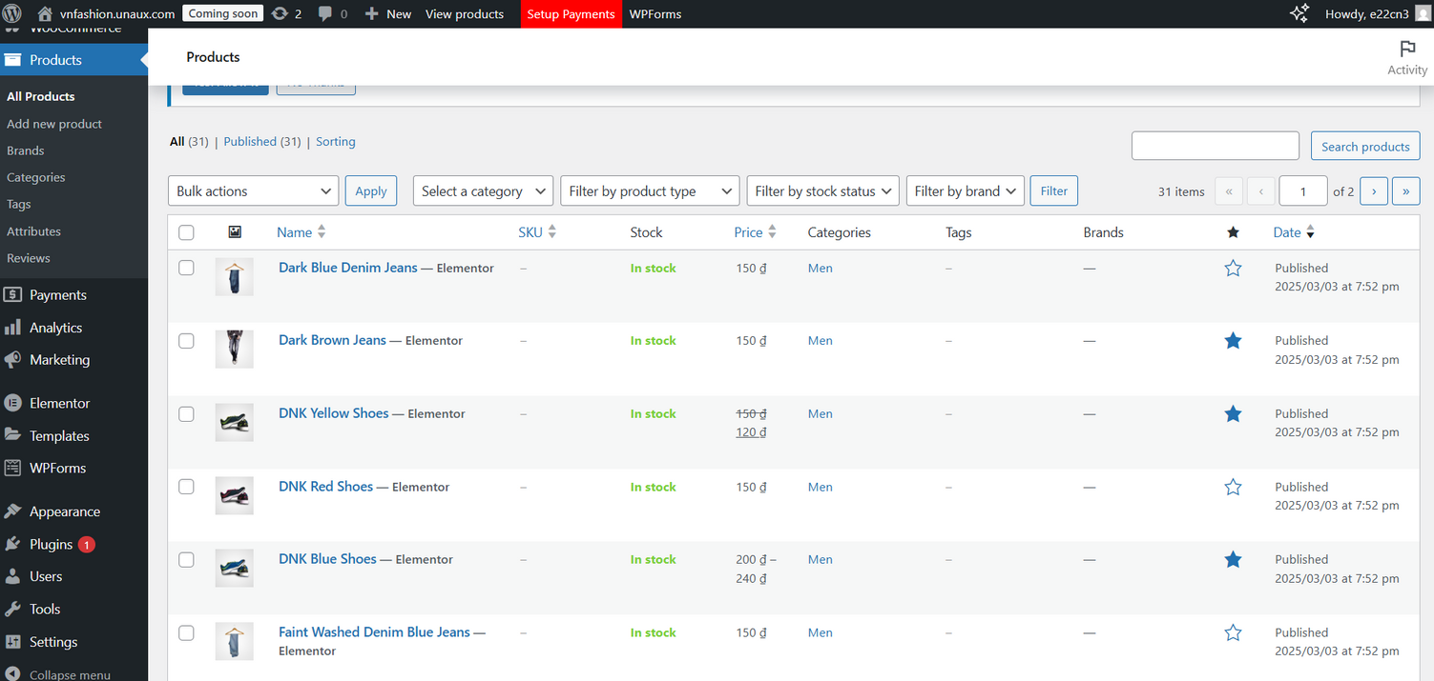
Studio Shodwe
Home
Service
About Us
Contact
Products
04

Slide 14
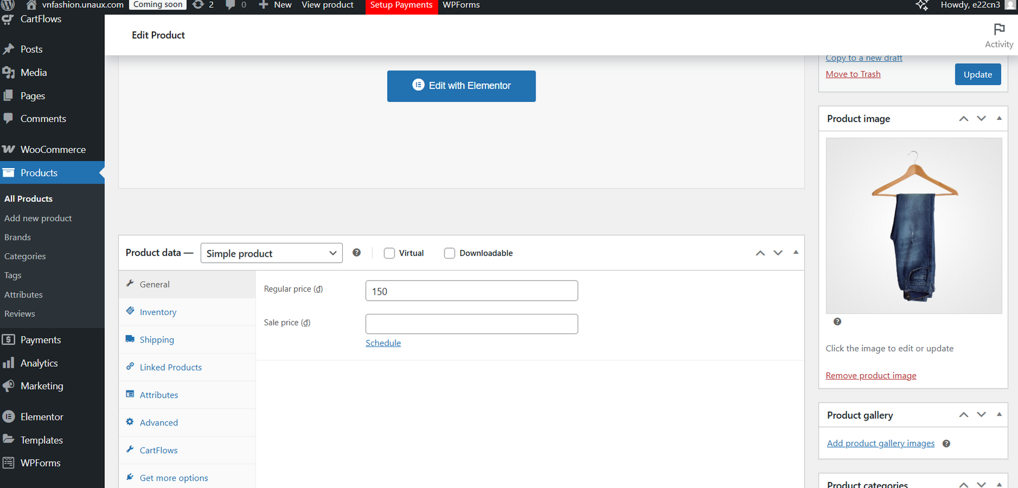
Studio Shodwe
Home
Service
About Us
Contact
Products
04

Slide 15
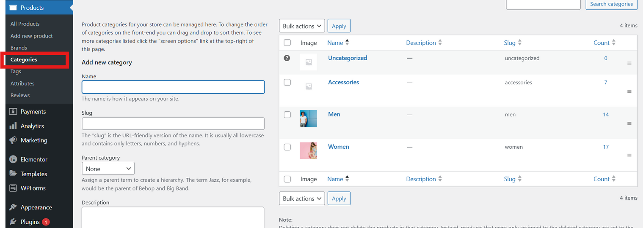
Studio Shodwe
Home
Service
About Us
Contact
Creating Categories
04

Slide 16
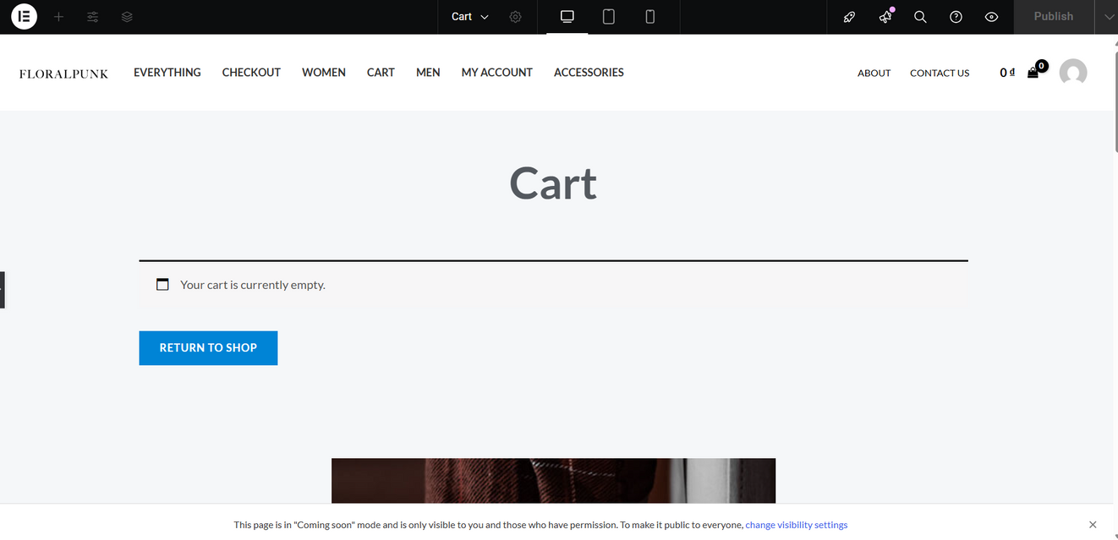

Home
Service
About Us
Contact
Cart Page
04

Slide 17
eCommerce Website Structure
01
03

Slide 18


Studio Shodwe
Home
Service
About Us
Contact
Thank You For Listening !
10

